Slide 1
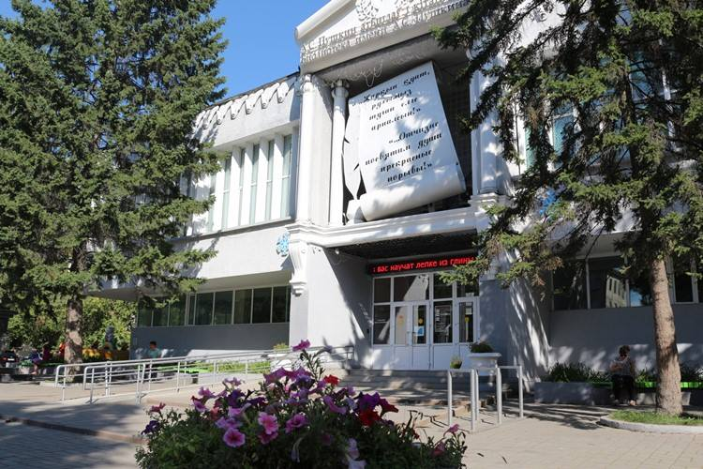
Meet New People at the East Kazakhstan Public Library named after A.S.Pushkin! (founded in 1896, book fund: 327 710 ) Making new friends! www.pushkinlibrary.kz

Slide 2
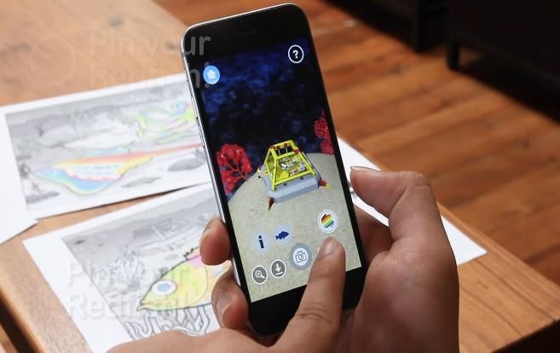
Приложение «Spectacular/Quiver - изумительный раскраски с 3D реальностью скачать приложение на сайте: https://quivervision.com/ бесплатные раскраски для скачивания https://quivervision.com/coloring-packs Spectacular! Reality App Instructional Video https://www.youtube.com/watch?v=eoGLoAKbjuM https://www.youtube.com/watch?v=fHpZGUjiEOU https://www.youtube.com/watch?v=of-Cr1R6X5g

Slide 3
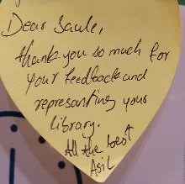
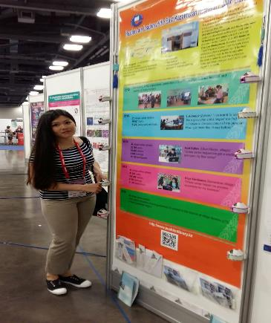
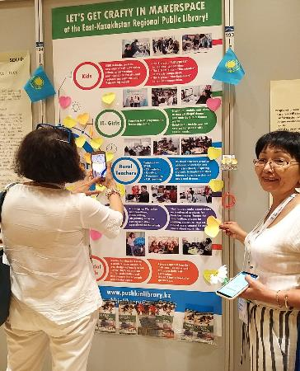
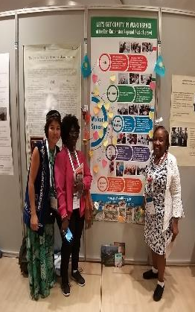
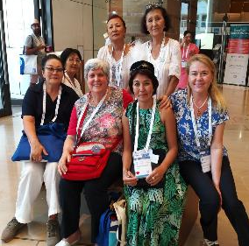
IFLA Conference, trainings, grants for Librarians, meet new partners
Library Associations and their members actively participate in the International Library organisations at IFLA World Conferences www.ifla.org
Best IFLA Poster in Columbus 2017, Maker Space IFLA Poster in Greece 2019

Slide 4
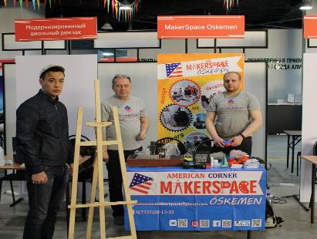
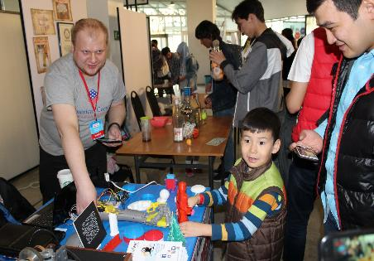
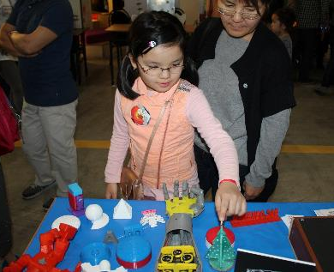
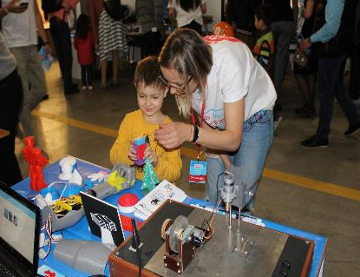
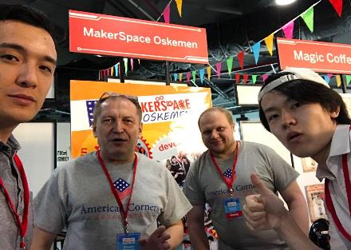
Almaty Mini Maker Faire - the first festival in Central Asia in 2018
https://youtu.be/uhYNy-YZSq4

Slide 5
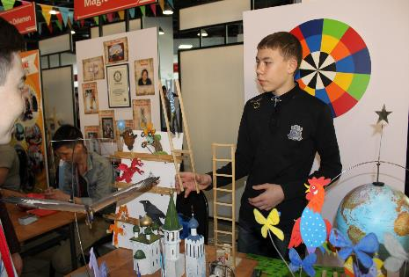
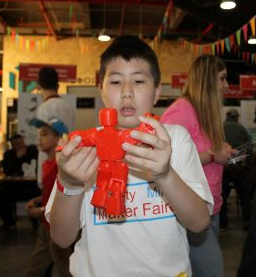
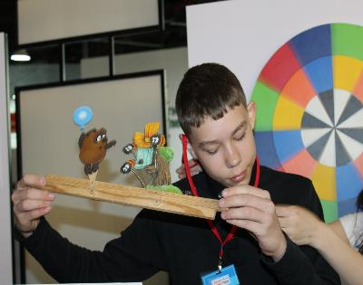
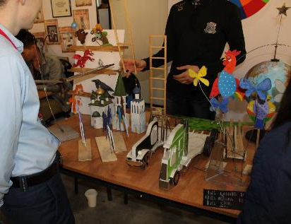
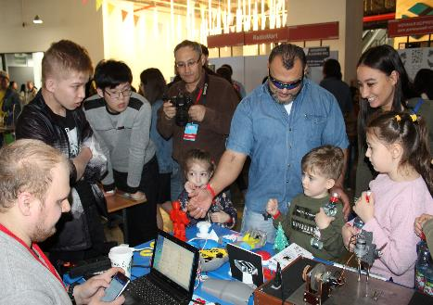
Almaty Mini Maker Faire - the first festival in Central Asia in 2018

Slide 6
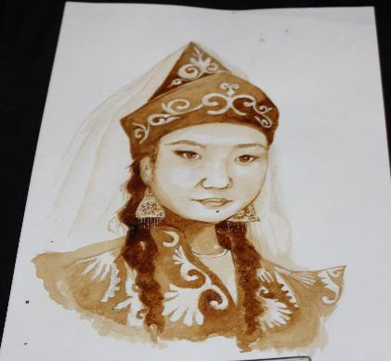
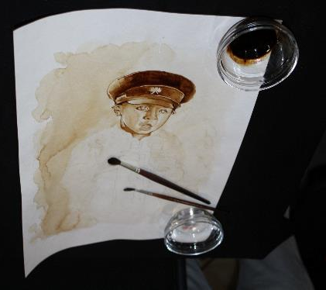
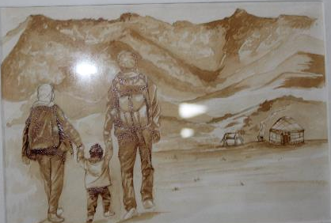
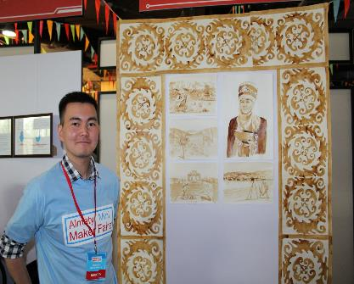
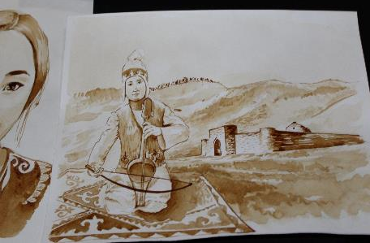
Almaty Mini Maker Faire 2018

Slide 7
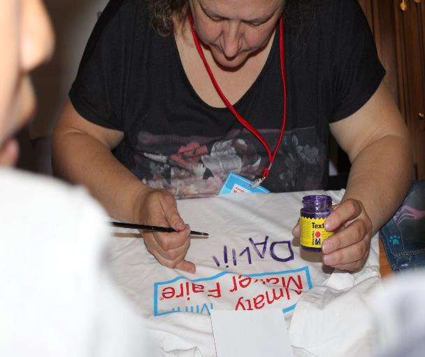
Almaty Mini Maker Faire 2018

Slide 8
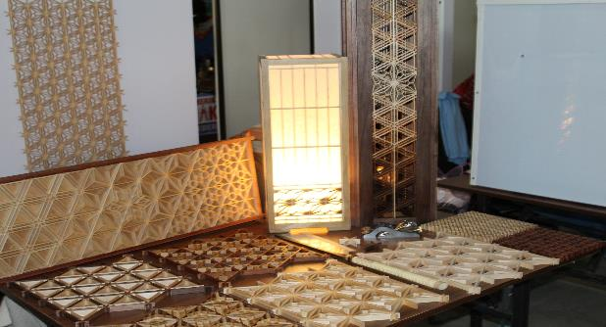
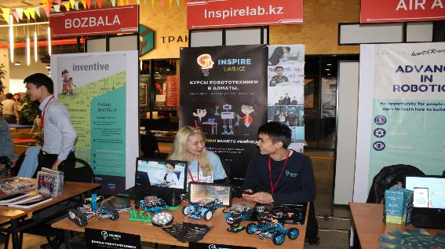
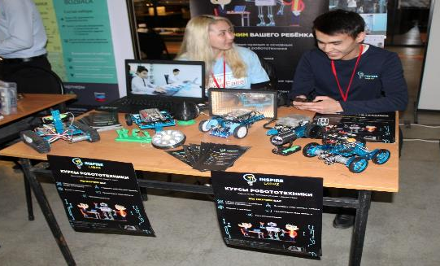
Almaty Mini Maker Faire 2018

Slide 9
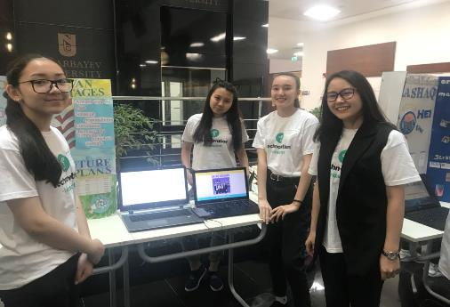
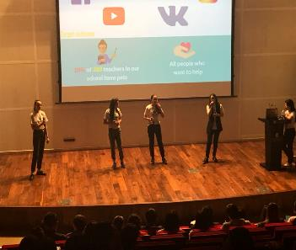
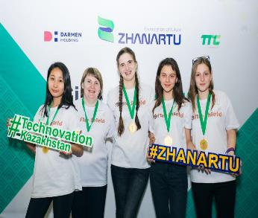
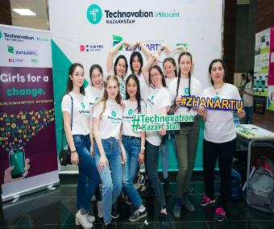
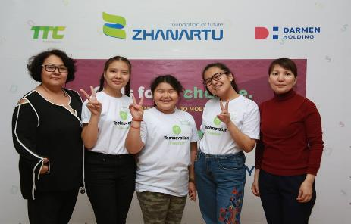
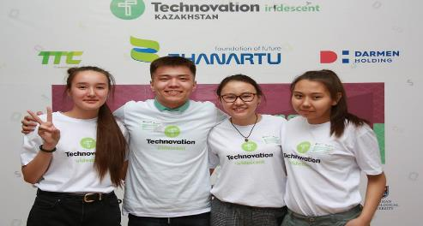
Technovation contest

Slide 10
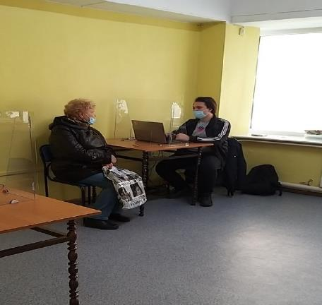
Library Services in pandemic time COVID-19

Slide 11
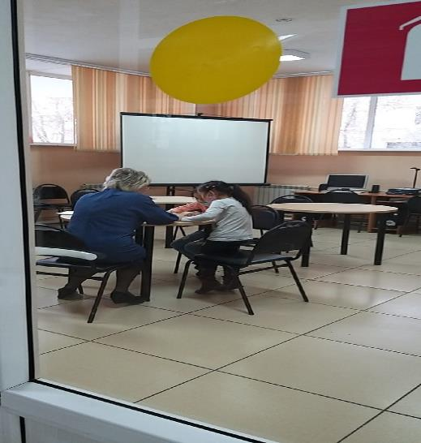
We teach Kazakh language for kids

Slide 12
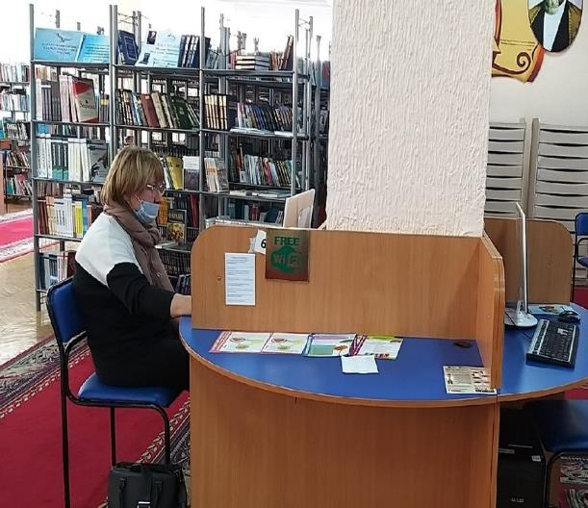
Reading Hall

Slide 13
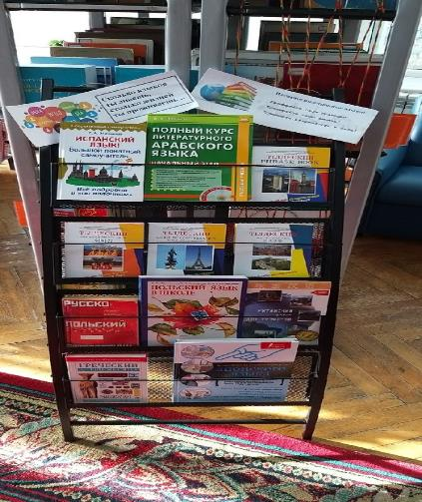
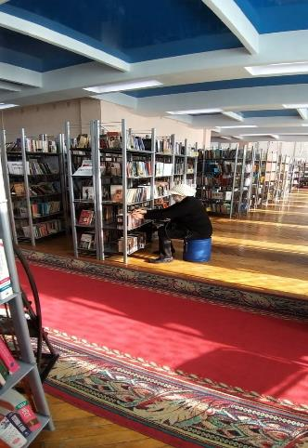
Reading Hall

Slide 14
Reading hall

Slide 15
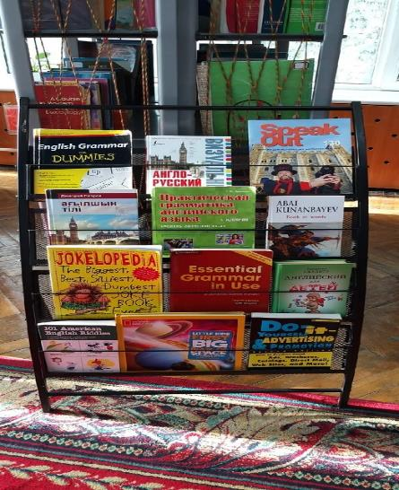
Exhibitions

Slide 16
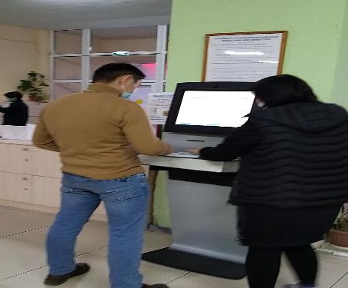
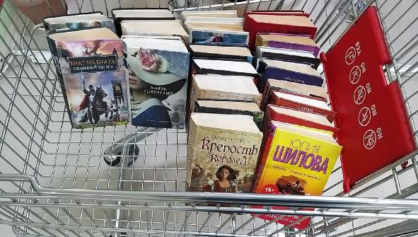
Reception

Slide 17
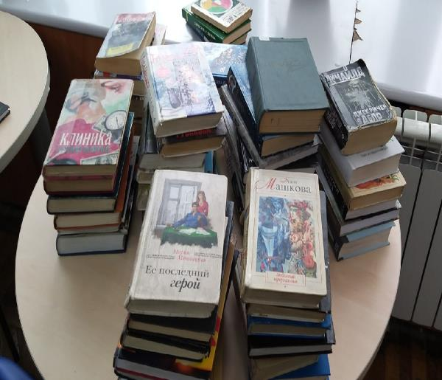
Reading hall

Slide 18
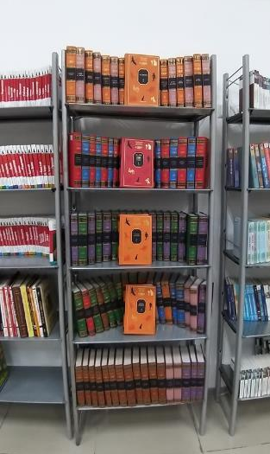
Reading hall

Slide 19
Computer literacy

Slide 20
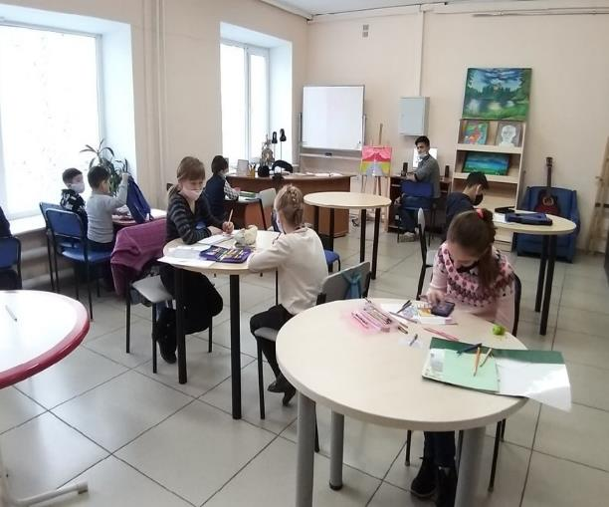
Robotics club and art club

Slide 21
American Corner Books

Slide 22
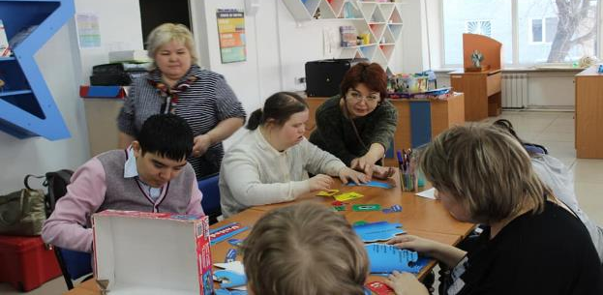
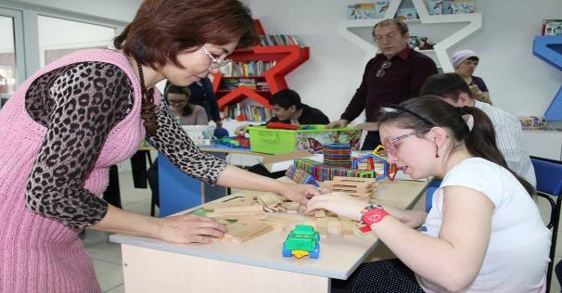
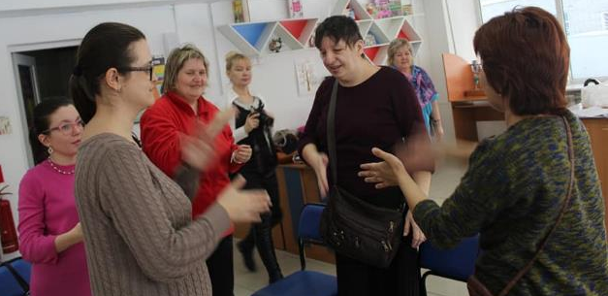
What do we need to improve people’s life?

Slide 23
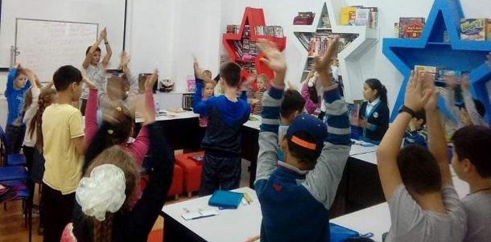
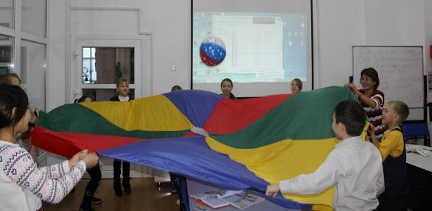
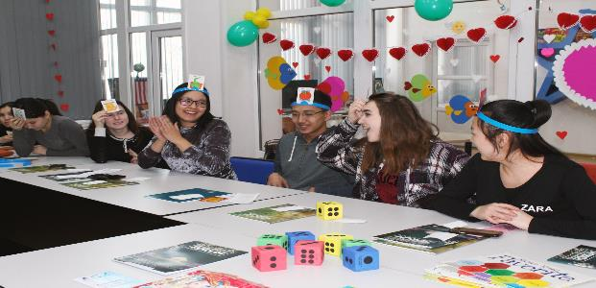
English clubs

Slide 24
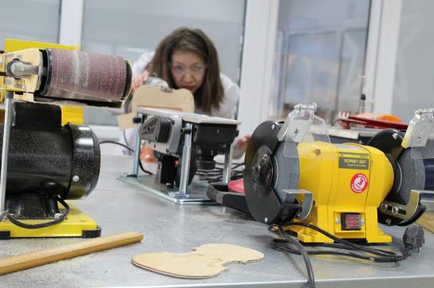
Learn! Come and See!

Slide 25
Let’s create and innovate!

Slide 26
Pre-school preparation with psychologist

Slide 27
Creative Space in our Public Library

Slide 28
IT Fests

Slide 29
Journalism club

Slide 30
Online Arduino Clubs

Slide 31
Online IT trainings

Slide 32
Uni Library

Slide 33
Portable Uni Library in parks

Slide 34
Portable Uni Library at Universities etc.

Slide 35
Chess clubs

Slide 36
Children Space

Slide 37
Children Space

Slide 38
Teaching Seminars

Slide 39
How to protect our nature from pollution? Ecological Flash mobs, challenge in waste management “TrashOut!

Slide 40
Photoshop, Corel Draw courses,123 Design

Slide 41
STEM for teachers

Slide 42
STEM for teachers

Slide 43
Competition at ALTAI’ROBO 2017

Slide 44
Robotics clubs

Slide 45
IT-forum «Smart – education»

Slide 46
Attraction of Partners, Sponsorship projects

Slide 47
Workshops at American Corner

Slide 48
STEM for Subject Teachers

Slide 49
Reading hall

Slide 50
Competitions at "KazRoboSport-2017“/ "KazRoboProject-2017

Slide 51
Exhibitions devoted to significant dates

Slide 52
Sharing experience in mass media

Slide 53
Creative Art clubs

Slide 54
3D printing

Slide 55
Open Spaces at Coworking Center

Slide 56
3 D Carvey Machine Project Ideas

Slide 57
English Access Microscholarship Program students published “Access Cook Book” with recipes

Slide 58
published “Comic Book” in 3 languages

Slide 59
Business English for Entrepreneurs by support of U.S.Embassy Strong communication skills to be Successful!
December 2017

Slide 60
Learn! Come and See! Workshops, inspirational speeches etc.

Slide 61
IELTS preparation course by support of U.S.Embassy
June 2019

Slide 62
Join our Team!
Website: www.pushkinlibrary.kz
Tel: 8 705 127 29 36
E-mail: e.saule@mail.ru

